Slide 1
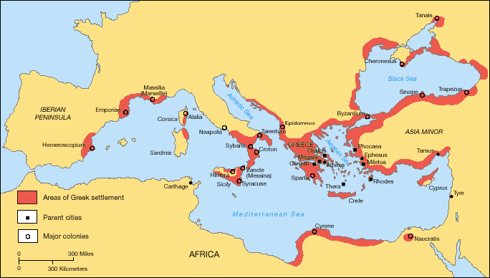
Do Now: What are four external forces which have an impact on your life?
Focus: To what extent did the geographical features impact the development of unique Greek city- states?
Reminders:
Pgs.158-166 Textbook Outline 14 bullet points in your notebook due 11/12.

Slide 2
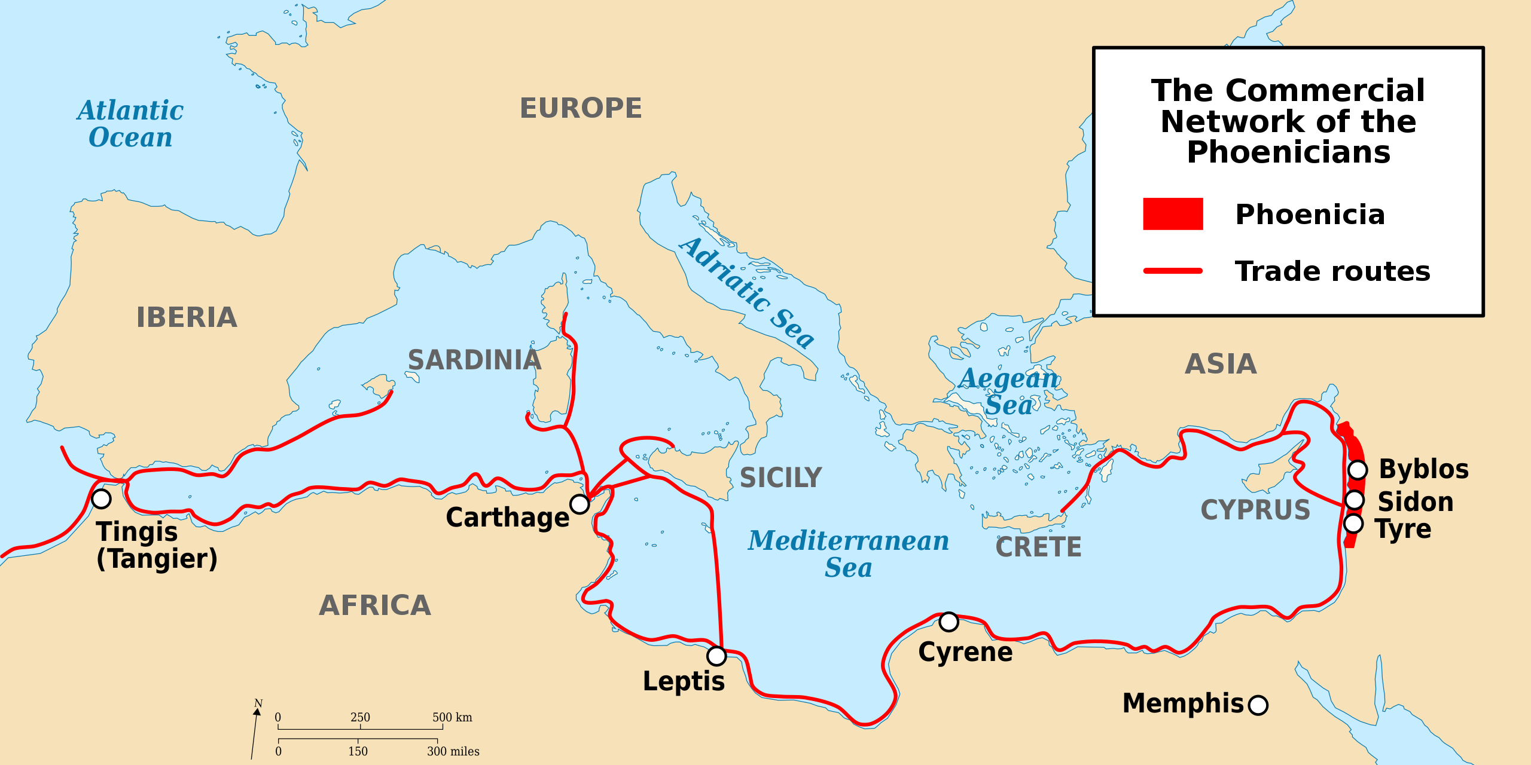
The Phoenicians
The Phoenicians original territory
was just north of Israel and Jerusalem, in the modern-day country of Lebanon
A seafaring people that established coastal city-states throughout the Mediterranean beginning in 900 BCE.
The Phoenicians created and spread a writing system with 22 consonants and vowels based on phonetic sound without symbolic meaning. (AKA- an alphabet).
This alphabet would influence the creation of both the Greek and Roman alphabets.
Greece art, culture and trade was also greatly influenced by the Phoenicians.
Were conquered by Persia in 539 BCE under Cyrus the Great.

Slide 3
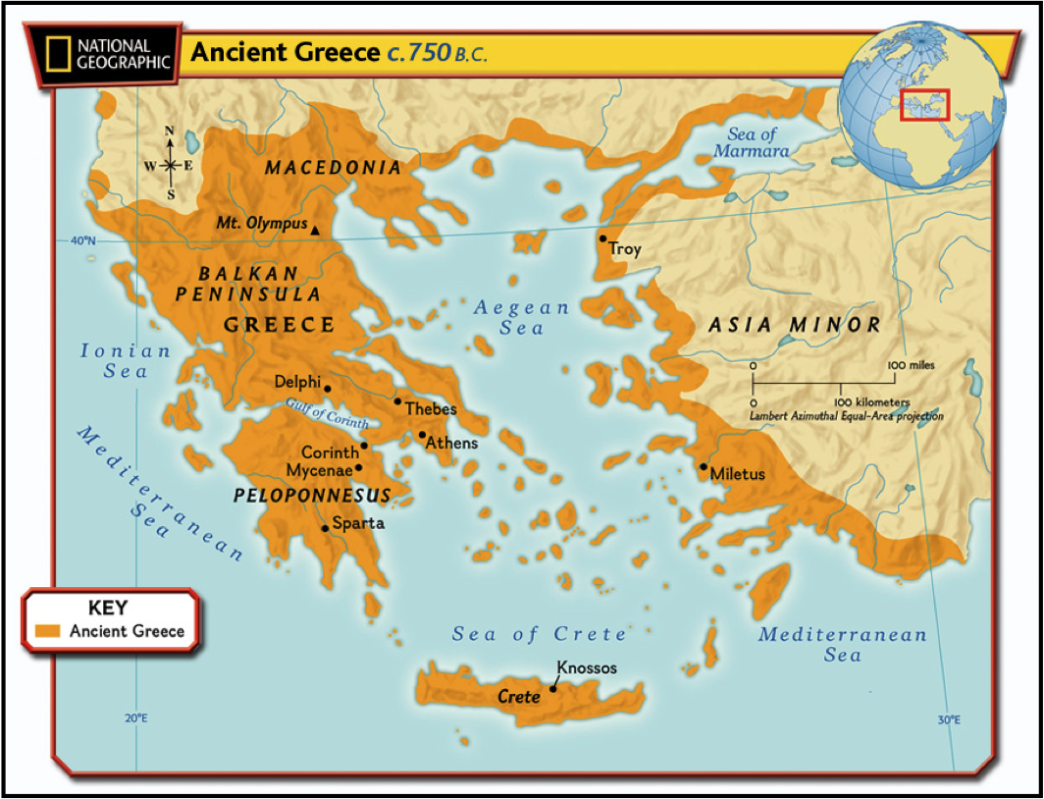
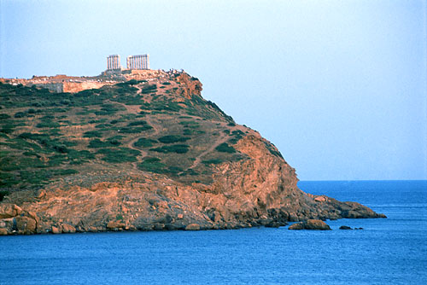
Focus: To what extent did the geographical features impact the development of Greek city- states?
Geography
Greece is a mountainous peninsula with many islands in the Aegean and Mediterranean Sea. It is considered an archipelago. Agriculture was based primarily on the production of olives, grapes and barley.
Classical Greece never formed a true unified empire. Rather it was built from hundreds of autonomous city states.

Slide 4
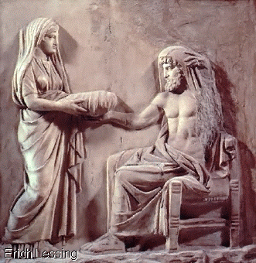
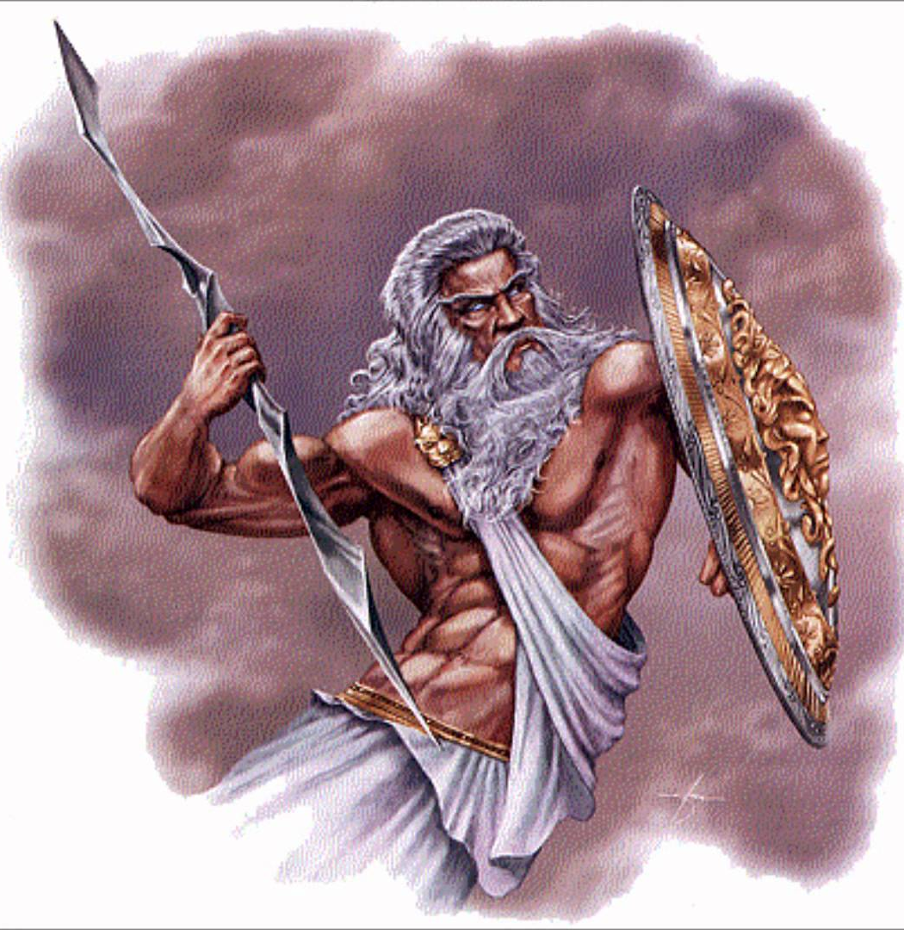
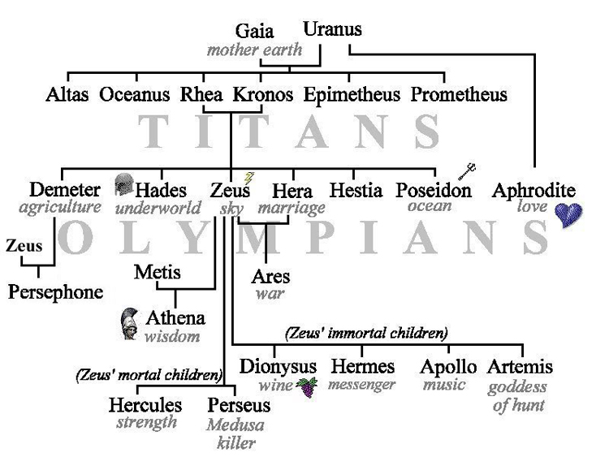
Focus: To what extent did the geographical features impact the development of Greek city- states?
Greek religion was highly polytheistic as each city state dedicated its temple to their own god or goddesses.

Slide 5
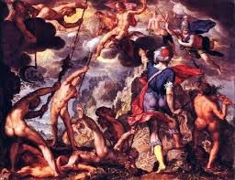
Video
The Creation of the World
https://www.youtube.com/watch?v=U_u91SjrEOE

Slide 6
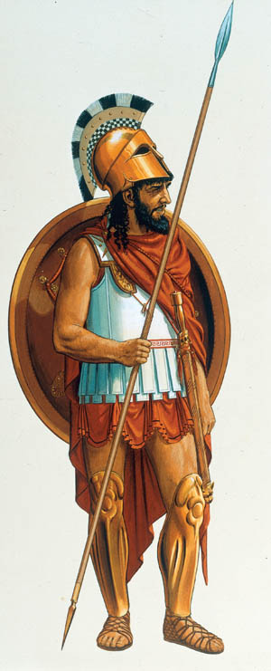
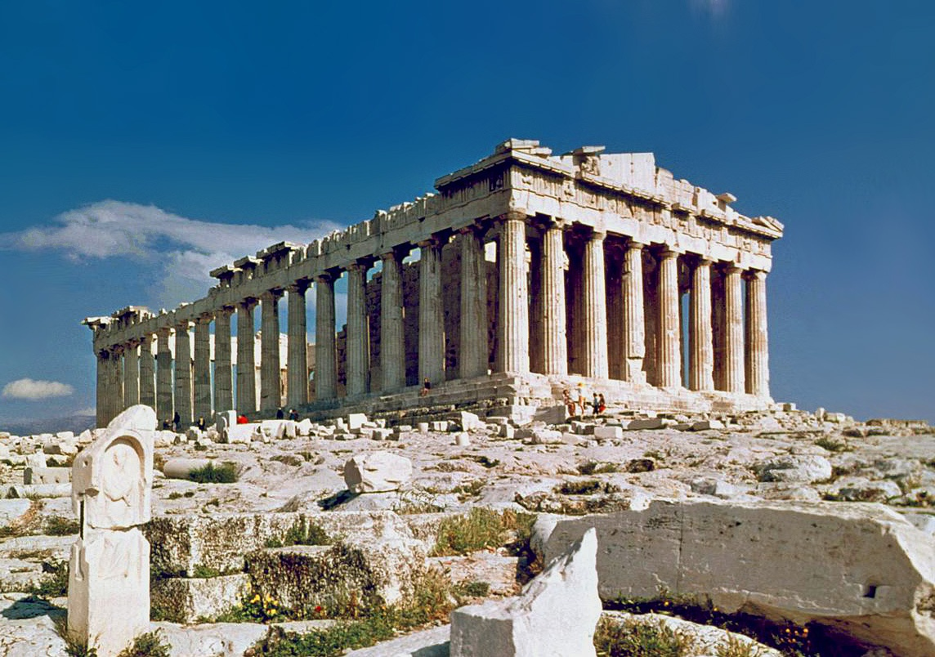
The Greek City State
What’s the big idea?
The two most powerful city-states in Greece, Sparta and Athens,
had very different cultures and became bitter enemies.
A city-state, or polis, was the community structure of ancient Greece. Each city-state was organized with an urban center and the surrounding countryside.
Characteristics of the city in a polis were outer walls for protection, as well as a public space that included temples and government buildings. The temples and government buildings were often built on the top of a hill, or acropolis.

Slide 7
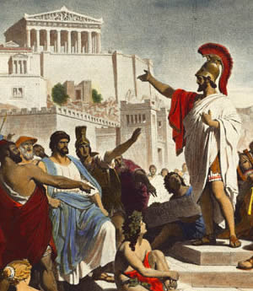
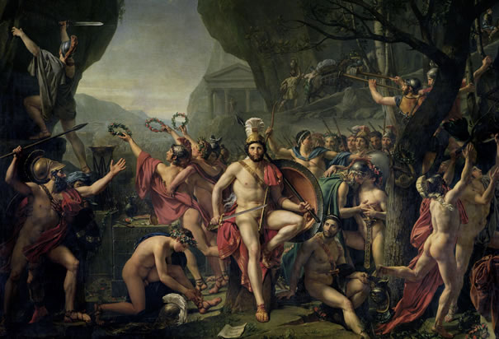
Athenian | Spartan
Athens
Sparta
Do you consider yourself to be more of an Athenian or a Spartan? Reference specific historical facts from our sources and explain how they relate to you!

Slide 8
Comparing the Two Most Powerful City States
Athens
Sparta
Had a strong focus on participatory government, education and philosophy. Male citizens could vote directly or for representatives.
Women had limited participation in life in the public sphere and only the wealthiest women were educated.
Had a very strong navy.
Home to world famous philosophers like Socrates, Plato and Aristotle and the historians
Boys were educated as early as seven years old.
Athens used foreigners (Non-Greeks) as slaves who were given small pay and some limited freedoms.
Government was focused on military organization. Most boys received military training as for at least 10 years.
Women were respected in this culture as they were responsible for creating strong soldiers for battle.
Women could own property and were trained in the military. Fit mothers= fit soldiers and more fit mothers.
Unhealthy babies were often abandoned in the wilderness as to not put unneeded strain on the City-State.
Sparta used indigenous Spartans called helots as slaves. Some historians consider Spartan slavery to be the harshest of the classical period.

Slide 9
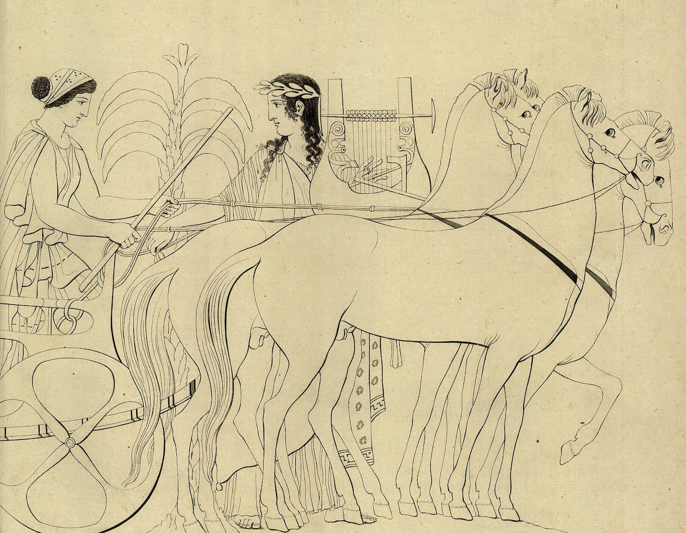
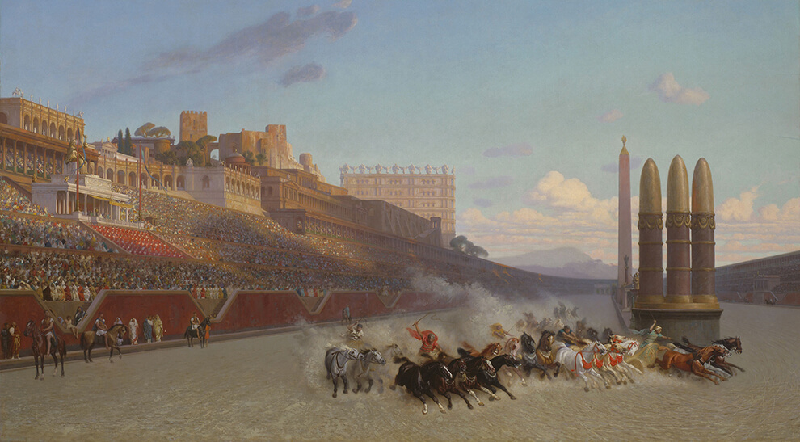
Cynisca
Born in Sparta in 440 BCE
-Was a Spartan royal princess who became the first female Olympic champion. She won the event of chariot racing in 396 BCE and 392 BCE.
-She did not race in the event but bred and trained the horses for her charioteers.
-Various statues and monuments of her were erected at temples and were religiously venerated after her death.

Slide 10
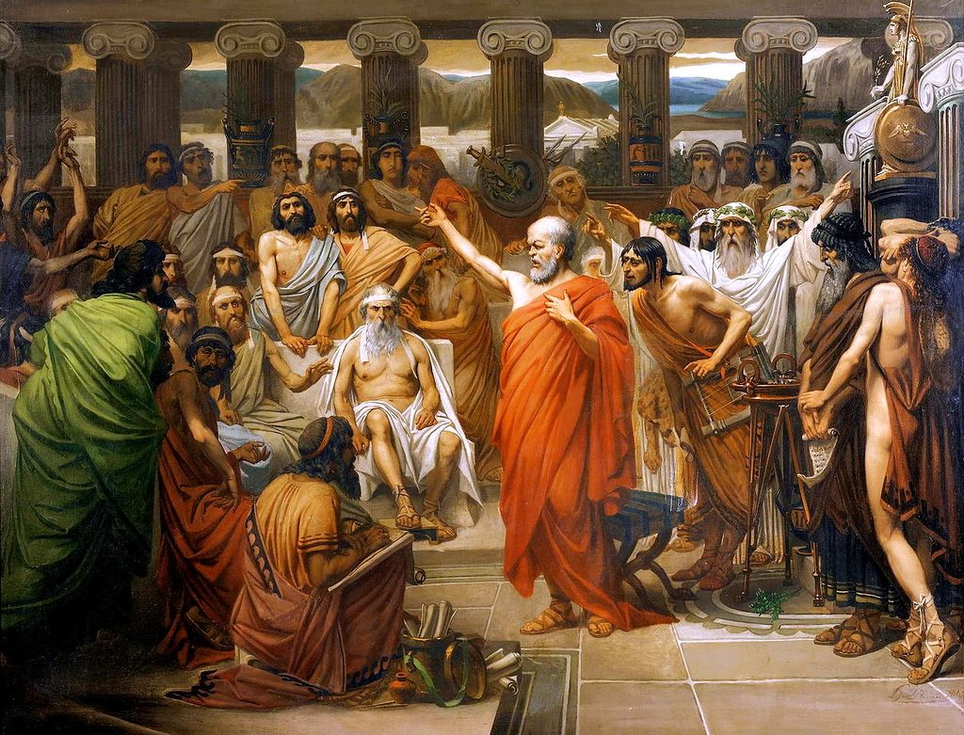
Athenian Quotes:
Let there be light! Said Liberty, And like sunrise from the sea, Athens arose!
What you leave behind is not what is engraved on stone monuments, but what is woven into the lives of others. Those who can truly be accounted brave are those who best know the meaning of what is sweet in life and what is terrible, and then go out, undeterred, to meet what is to come.
Athens, the eye of Greece, mother of arts and eloquence, native to famous wits.
Ye men of Athens, I perceive that in all things ye are too superstitious.

Slide 11
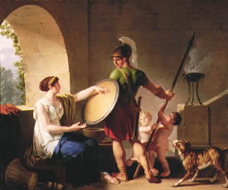
Spartan Quotes
“Come and take them.” - Spartan General Leonidas’ written response to Persian Emperor Xerxes, who asked him to lay down his weapons in surrender.
'Son, either with this or on this.'
'You should reach the limits of virtue, before you cross the border of death. '
'How glorious fall the valiant, sword in hand, in front of battle for their native land!'
'...learn to love death's ink-black shadow as much as you love the light of dawn. '
'Here is courage, mankind's finest possession, here is the noblest prize that a young man can endeavor to win.'

